Slide 1
Linking Standards, IFSPs and Service Delivery
A Challenge and An Opportunity!

Slide 2
How did we get here??
The PA Standards for Early Childhood, Infant/Toddler are not new. You probably remember talking about them in the past. However, they were revised in 2014, and are now required for use in all OCDEL programs, including Early Intervention.
Each EI program had to do an Action Plan to determine how the PA Standards would be used within their system. With the help of several local stakeholders who use or provide EI services, we came up with a training plan and accessed the materials to make this process easy for staff and fun for families. Your peers put this information together, and will be using the tools along with all of you.
We did an in-person training in October, 2015, and have now made the training available to everyone using an online website. So glad you found us!!
Through this training, we will share our ideas for using the Standards with families in EI. You will get some great ideas, but these are only examples to get you started. As we all get more comfortable with the tools we have available, we want folks to talk and share the ideas they have.
Don’t be shy, let us know what is working for you!! How are you documenting what you do?? How are families responding?? How easy is it to relate the Standards to a child’s IFSP outcome and strategies? To Coaching??

Slide 3
Training Objectives = AWARENESS!!
Familiarize and learn about the PA Learning Standards
Understand how the standards will support and enhance service delivery
Share resources provided in order to easily share the standards with families
Provide therapists with tips for documentation

Slide 4
Standards are …
A set of principles and values that are the foundation for the way in which a program operates
A framework that reminds us all what typical development looks like; what expectations are reasonable for children. Helps families understand how children typically develop, how skills build on each other as children grow.
A set of common elements that can be used across all similar programs to benefit young children’s learning. Did you know that Keystone Stars child care programs, Head Start, and other OCDEL professionals are already using the PA Standards for Early Childhood? That provides a common language for explaining development and our IFSP outcomes to the important people in the child’s world.
Families will hear about Learning Standards in a variety of ways as the child grows and goes through school. Families can start to understand how the Standards work even if their child is an infant. And it can be fun!!

Slide 5
Standards are NOT …
A curriculum– There are no lesson plans or prescribed steps for intervention.
IFSP outcome/goals- We do NOT expect you to reference or document a specific Standard number on IFSP outcomes or strategies developed with the family.
An assessment-No developmental scores or eligibility results.

Slide 6
Why Standards?
Standards guide the intentional instruction of ALL young children in ALL learning settings, including the home. They can be adapted for use with children who have significant global delays or medical complications by looking at developmental level rather than chronological age.
Standards inform practitioners and families/caregivers, enhancing the learning principles associated with goals/outcomes. Helps us show families what they are already doing to support their child’s development, and offers new ideas to try within typical routines/activities.
And do you know how YOU are already using the PA Standards for Early Childhood???

Slide 7
Introduction to the PA Standards

Slide 8
Age Groupings
Infant
Young Toddler
Older Toddler
Pre-Kindergarten
Kindergarten
Birth-12 months
9-27 months
24-36 months
3-5 years (60months)
5 years of age
(by Sept. 1)

Slide 9
Guiding Principles
(page 8)
Define high quality early childhood programs including EI
Emphasize what Pennsylvania feels are the essential elements that support high quality services

Slide 10
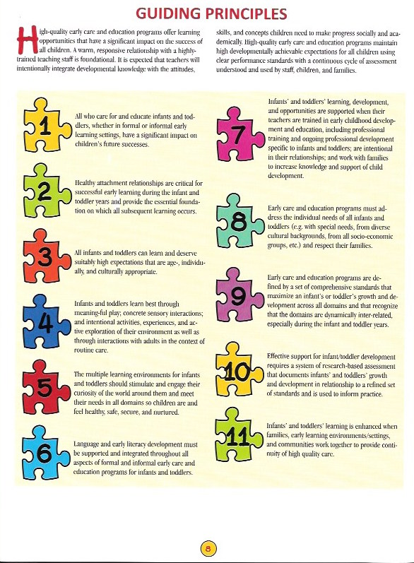
8

Slide 11
Organization Of PA Standards

Slide 12
9 Key Learning Areas
Approaches to Learning through Play
Language & Literacy Development
Mathematical Thinking & Expression
Scientific Thinking & Technology
Social Studies Thinking
Creative Thinking & General Knowledge
Health, Wellness & Physical Development
Social & Emotional Development
Partnerships for Learning

Slide 13
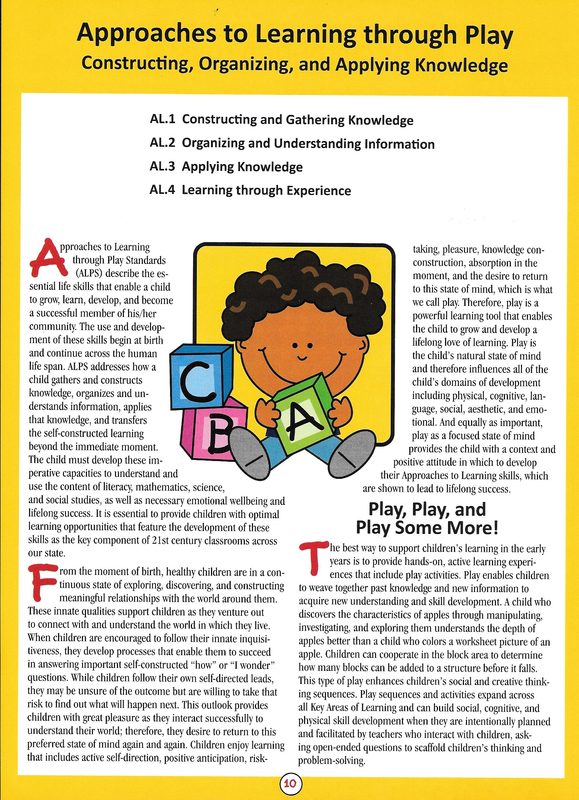
Title Page
One for EACH Key Learning Area-the domains of learning that assure a child’s holistic learning
Tagline
Descriptive Paragraph
Table of Contents (Standards booklet pages 2-3)
Standard Area #
Standard Descriptor

Slide 14
Organization of Key Learning Areas
Numbered Standard Area-allows for smaller topics in each Key Learning Area
Big Ideas-describes the information that children should acquire across all age levels – the main concept
Essential Questions-linked to the BIG IDEAS and provides the questions that support children’s inquiry

Slide 15
Organization (cont.)
Broad Standard Statement-summarizes the key focal points found within the standard statements
Standard-a specific skill a child should know by the end of the developmental age range
Concepts and Competencies-skills that help to define the construct of the STANDARD
Supportive Practices-practitioners and families can employ these strategies to help children learn or make progress with particular skills

Slide 16
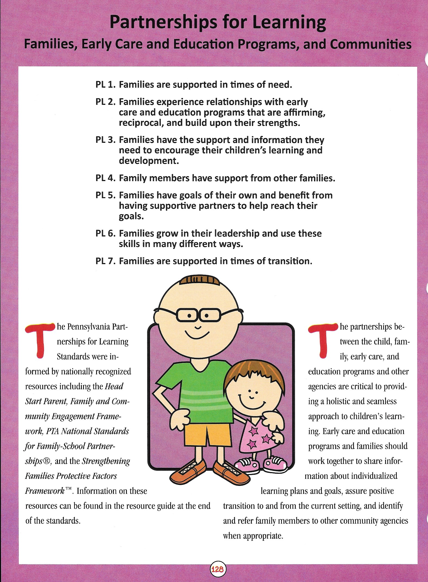
Partnerships for Learning is unique to the PA Learning Standards for Early Childhood.
The partnerships between the child, family, early care, and education programs and other agencies are critical to providing a holistic and seamless approach to children’s learning.
Early care and education programs and families should work together in order to share information about individualized learning plans and goals, assure positive transition to and from the current setting, and identify and refer family members to other community agencies when appropriate.

Slide 17
Glossary
(See page 23)
Placed at the end of each Key Learning Area
References “key words” used in that Key Learning Area

Slide 18
Resources
Arranged by Key Learning Areas
Found at the end of the Standards on page 139
Contains articles, books, and websites

Slide 19
Challenge and Opportunity
Teams can use this information to remind us what is developmentally appropriate and can help us show families what skills the child needs to build upon
The standards show steps that are necessary for a child to build upon in order to support the “Big Idea” and can be used with families as their child moves through early intervention
Teams can explain the rationale for the standards with families and community partners and document in session/service notes
Teams can use the Checklist to validate how we are already using the Standards in our therapy services

Slide 20
Process of Introducing the Standards in EI
SC Role
Evaluator Role
Provider Role

Slide 21
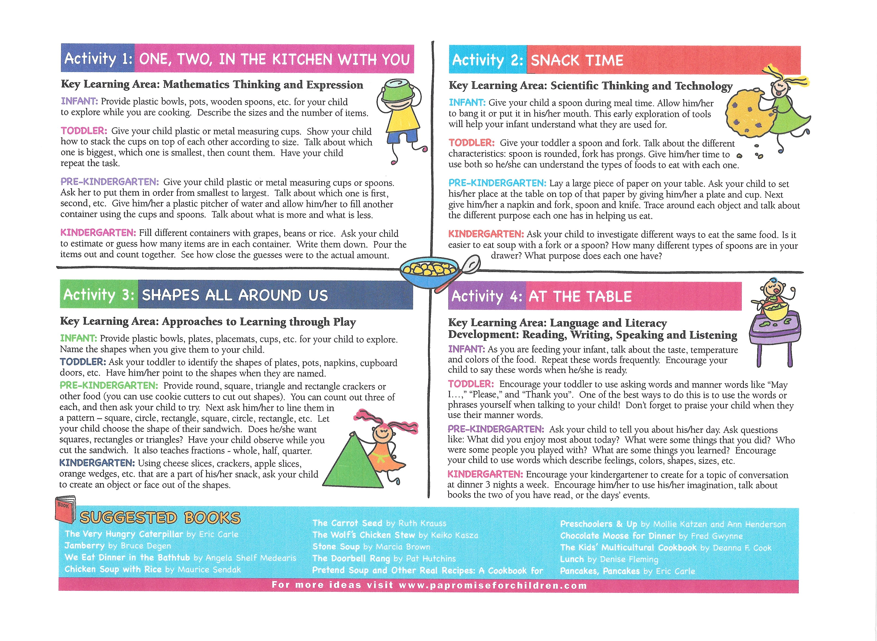
Activity from Learning is Everywhere

Slide 22
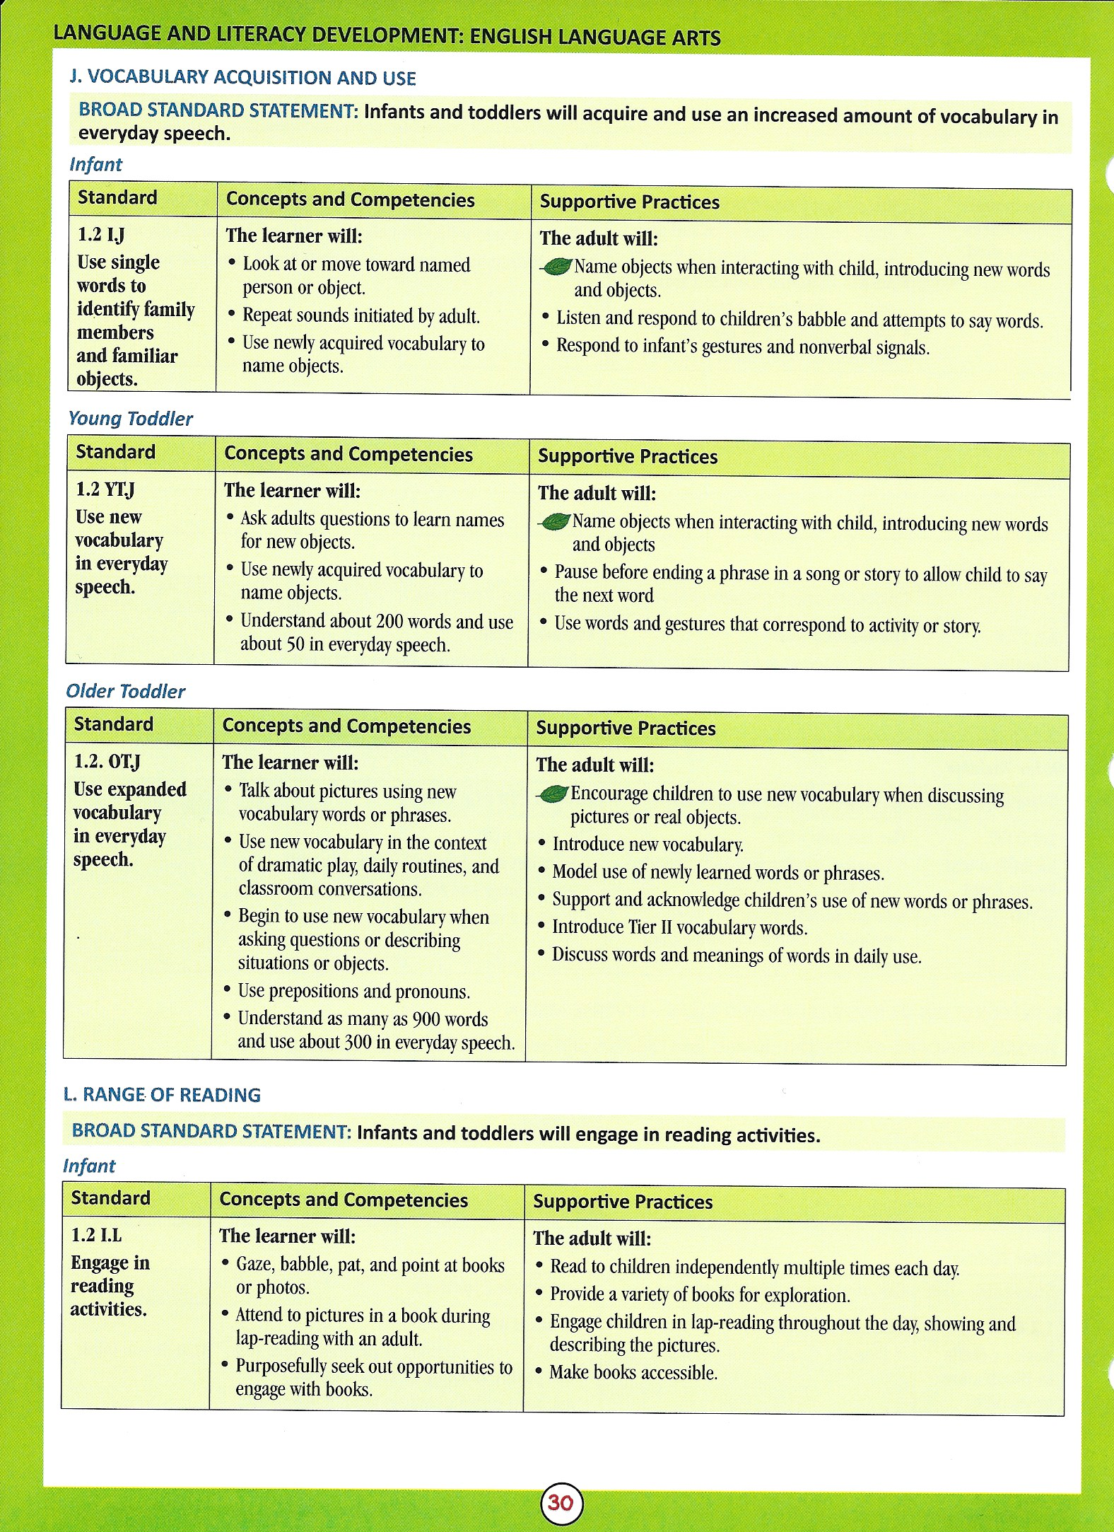
How the Activity Ties in with the IFSP and the PA Standard

Slide 23
Documentation
How to Document the Discussion about the Standards with Families

Slide 24
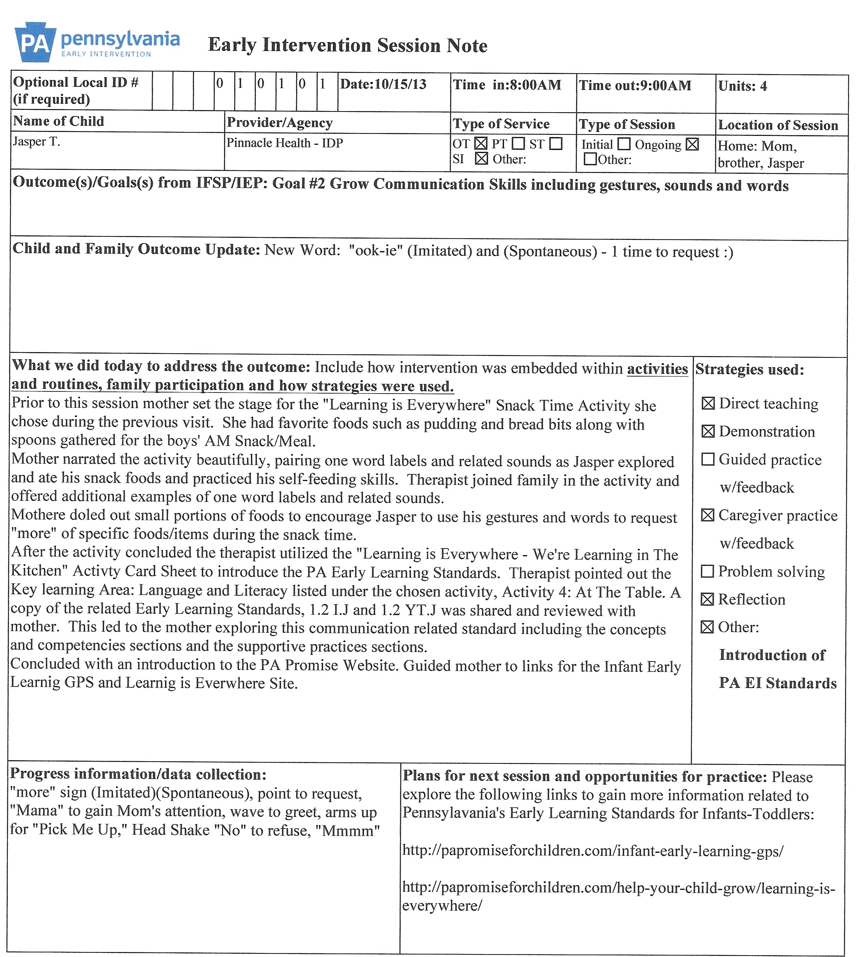

Slide 25
Additional Resources
PA Promise for Children
http://papromiseforchildren.com/
Early Learning GPS
https://www.earlylearninggps.com

Slide 26
One Size Does Not Fit All

